Slide 1




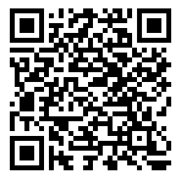
Robustification of Behavioral Designs against Environmental Deviations
Changjian Zhang¹, Tarang Saluja², Rômulo Meira-Góes³, Matthew Bolton⁴, David Garlan¹, Eunsuk Kang¹
^{1.} Carnegie Mellon University
^{2.} Swarthmore College
^{3.} The Pennsylvania State University
^{4.} University of Virginia
READ OUR PAPER HERE!

Slide 2

Introduction and Contributions
Behavioral robustification, a technique that systematically improves the robustness of a system.
A definition of robustification and its formulation as a multi-objective optimization problem with two quality goals:
maximizing the amount of preserved existing functionality, and
minimizing the cost of changes.
A novel approach to the problem with a set of heuristics for efficiently generating optimal redesigns.
Evaluated under three case studies and compared with existing methods.

Slide 3
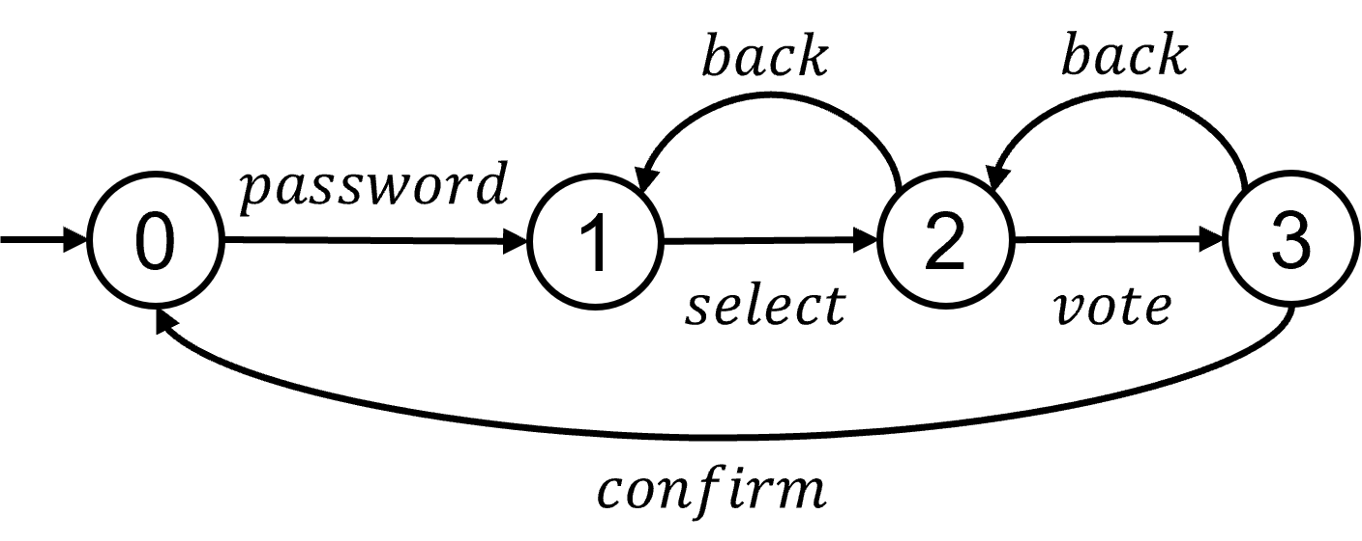
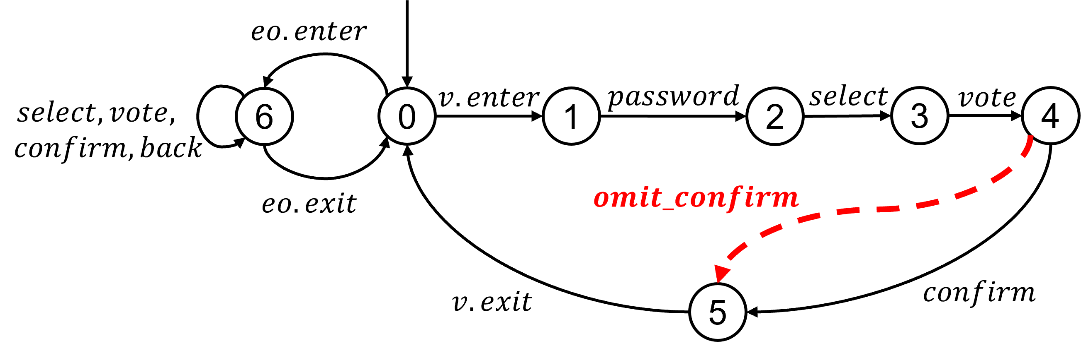
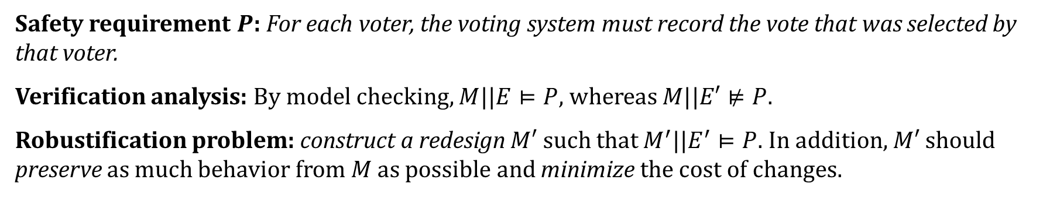
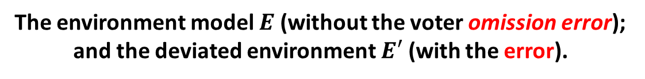
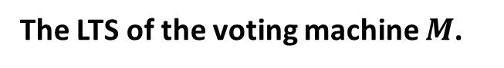
An Illustration Example: The iVotronic Voting Machine
The LTS of the voting machine $M$.
The environment model $E$ (without the voter omission error); and the deviated environment $E′$ (with the error).
Safety requirement $P$: For each voter, the voting system must record the vote that was selected by that voter.
Verification analysis: By model checking, $M||E⊨P$, whereas $M||E′⊭P$.
Robustification problem: construct a redesign $M′$ such that $M^{′}||E^{′}⊨P$. In addition, $M′$should preserve as much behavior from $M$ as possible and minimize the cost of changes.

Slide 4
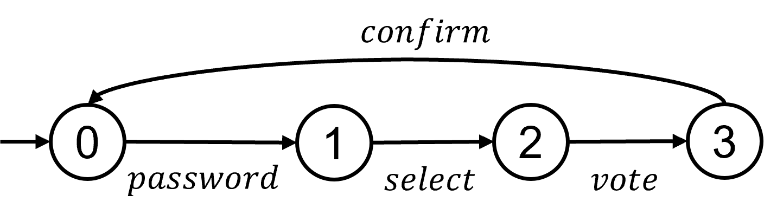
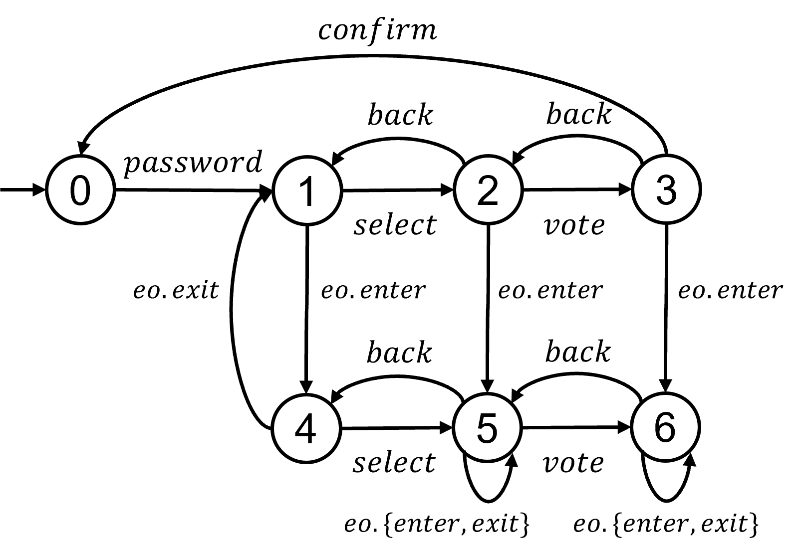


Design Trade-Offs of Robustification
Redesign by disabling all back transitions: It might be cheaper to remove the back buttons. However, no voter can ever change their vote.
Redesign by observing additional events eo.{enter, exit}: It allows the voter to change their vote. However, it might be more costly to monitor the official entering or leaving, potentially requiring additional ID scanners for identification.
Alternative (A)
Hard for developers to manually compare design alternatives.
We present an automated approach to generate valid redesigns and search for pareto-optimal solutions.
Alternative (B)

Slide 5
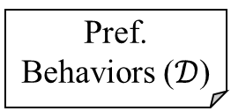
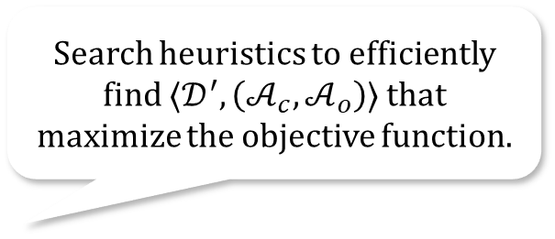
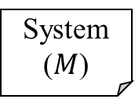
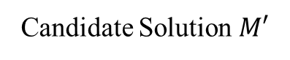
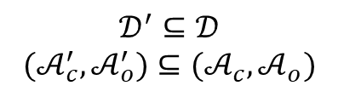
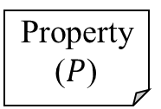
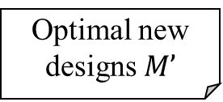
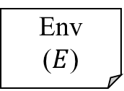
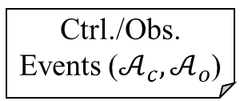
Approach Overview
Search heuristics to efficiently find $⟨𝒟^{′},\left(𝒜_{c},𝒜_{o}\right)⟩$ that maximize the objective function.
System ($M$)
Env
($E$)
Property ($P$)
$$𝒟^{′}⊆𝒟$$
$${(𝒜}_{c}^{′},𝒜_{o}^{′})⊆(𝒜_{c},𝒜_{o})$$
Design Optimizer
Supervisory Control Synthesis
Candidate Solution $M′$
Leverage supervisory control theory to synthesis valid redesigns.
Intolerable Dev. ($\overline{δ}$)
Pref. Behaviors ($𝒟$)
Ctrl./Obs. Events ($𝒜_{c},𝒜_{o}$)
Optimal new designs $M’$
Deviations that the system is not yet robust against.
Metric to quantify the preserved behaviors.
Metric to quantify the cost of changes.
Return pareto-optimal solutions.

Slide 6

Evaluation and Comparison
 | Vanilla |  | OASIS |  | Ours w/ Heuristics
 | Solution | Time | Solution | Time | Solution* | Time
Voting-1 | ✗ | 0.30s |  | 0.45s | ✓ | 0.54s
Voting-2 | ✗ | 0.36s | ✗ | 3.66s | ✓ | 1.14s
Voting-3 | ✗ | 0.58s | ✗ | 23.00s | ✓ | 4.69s
Voting-4 | ✗ | 1.30s | ✗ | 4m13s | ✓ | 28.31s
Therapy Machine | ✓ | 0.35s | ✓ | 0.37s | ✓ | 0.56s
Infusion Pump | ✗ | 0.42s |  | 1.04s | ✓ | 1.47s
Infusion Pump-2 | ✗ | 0.93s |  | 9.01s | ✓ | 12.47s
Compared to existing methods, our approach can:
find solutions that optimize against our quality goals,
with acceptable performance overhead.
✓: It finds one or more solutions and preserve all specified behaviors.
: It finds solutions but does not preserve all specified behaviors.
✗: It fails to find a solution.
*: Our solutions minimize the cost of changes, whereas other methods have fixed costs.
@eskang09
Interested?! Find more in our paper!

